Slide 1
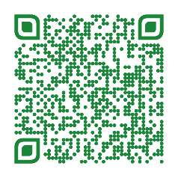
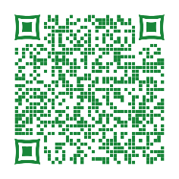
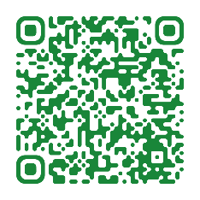
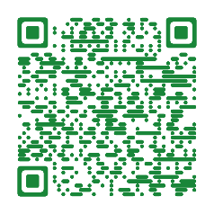
Coming Soon… Roth 401(k)
Learn all about Roth 401(k) and Roth Catch-up!
Join a live webinar hosted by Fidelity Investments
Learn about different ways you can contribute to your workplace savings plan
Understand how Roth contributions can affect your paycheck and your taxes
Understand the difference between a Roth IRA and the Roth option in your workplace savings plan
DATE: | December 8, 2023 | December 8, 2023 | December 14, 2023 | December 14, 2023
TIME: | 10:00 AM EST | 12:00 (Noon) EST | 10:00 AM EST | 2:00 PM EST
LINK TO REGISTER:

